Slide 1
Digital Mobile Radio
A Novice’s Perspective
November 2018
WE4TOM

Slide 2
DMR Radio
(That’s a little bit redundant)
Digital Mobile Radio

Slide 3
Things I’ve Learned
Since Delving into DMR.

Slide 4
What Do You Need to Acquire?
Repeaters
HotSpots
Radios

Slide 5

Shopping List
 |  | Amazon | E-Bay | Radioddity
1 | DMR Registration Number
 | DMR ID: RadioID.net - Free | $0
2 | Access to DMR Network (DMR also works Simplex)
 | Access to DMR Repeater: Free | $0
 | (Optional) DMR HotSpot: JumboSpot | $100 | $65
3 | DMR Radio, Some Popular Models
 | Radioddity: GD-77 | $95 | $80 | $75
 | Baofeng: RD-5R | $80 | $75
 | TYT: MD-2017 with GPS | $167 | $159
 | TYT: MD-2017 without GPS | $157 | $149
 | AnyTone: AT-D868UV with GPS | $179 | $179
 | AnyTone: AT-D868UV without GPS |  | $159
Prices as of 10-13-2018

Slide 6
What Do You Need to Understand
Code Plug
Consisting of:
Contacts
Receive Group
Channels
Talk Groups
Zones
Time Slots
Color Codes

Slide 7
What Do You Need to Acquire?
Repeaters
HotSpots
Radios
Elmer

Slide 8
Elmers
One of the advantages I have as a Novice DMR Operator is that I had newer radios to pick from when I started buying.
PARC Members I’ve heard on the Tidewater DMR 31515 Talk Group
KF4HJW kf4hjw@kf4hjw.org Darrell Sutton
    KN4KV me@phildrummond.com Phil DRUMMOND
N4BC dick@n4bc.com Dick Barnes
WZ4K WZ4K@arrl.net Howard Waxman

Slide 9
What Do You Need to Understand
Code Plug
Consisting of:
Contacts
Receive Group
Channels
Talk Groups
Zones
Time Slots
Color Codes

Slide 10
Code Plugs
A Code Plug is what you call the file you create that holds the customized settings for your radio. All the terms just presented, go into making the code plug. There are also some “One Time Settings” you make such as Call Sign and DMR ID.
All DMR Radios seem to have the same components. After you understand one manufacturer, you’ll easily follow another. Code Plugs from dissimilar radios are not likely to be interchangeable, but dissimilar radios work well together. I’ve discovered they tend to have capabilities of importing and exporting CSV files.

Slide 11
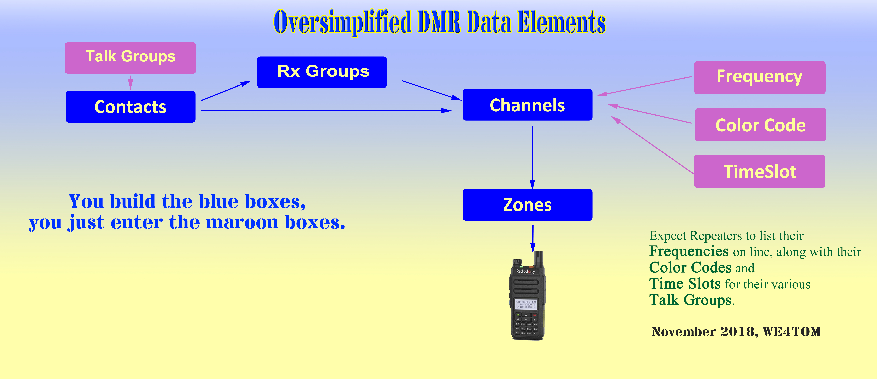

Slide 12
Talk Groups
Like a common meeting place. Like D-Star Reflectors - they can be worldwide. They are geographically oriented. There all also Talk Groups for various topics, such a vehicles, guns, and radio.

Slide 13
Contacts
Contacts Manage what we contact.
Either a Talk Group or a DMR ID. As you add items to Contacts, they will appear in Drop Down Boxes when you build Receive Groups or Channels.

Slide 14
Groups
Receive Group List - Seems to be needed to hear the other party. It seems to me that a Ham would expect it to be understood that you want to hear the person you are talking with. This feature could be more useful to First Responders or Support Groups, than to Hams. In most cases I have built a Receive Group of one Contact. A Contact can be a DMR ID or a Talk Group Number. Putting a bunch of people in one Talk Group gets very confusing.

Slide 15
Channels
Contacts, Color Codes, and Time Slots, along with Frequencies (and a few other settings) create a Channel (Record). The Channels are kept in a “folder like” creation, called a Zone.
The Radio Displays seem to be limited to 10 Characters. This led me to using Creative Cryptic Channel Names.

Slide 16
Frequency
This is the frequency the radio will transmit and receive. DMR is capable of both Duplex and Simplex.

Slide 17
Color Codes
They are like Tones. They help prevent undesired transmissions. There are only 16 of them. Ironically they are not colors, they are numbers, 0 through 15.

Slide 18
Time Slots
There are 2 Time Slots. These also can prevent transmissions. If you have the wrong Time Slot you won’t be able to communicate with your intended recipient. However, their purpose is to allow two communications to happen at the same time on the same frequency. They don’t interfere with each other. DMR uses TDMA.
Per Wikipedia: Time-division multiple access (TDMA) is a channel access method for shared-medium networks. It allows several users to share the same frequency channel by dividing the signal into different time slots. The users transmit in rapid succession, one after the other, each using its own time slot.

Slide 19
Zones
Collections of Channels. Zones seem to be limited to 16 Channels each on the GD-77.
You select a Zone, then a Channel within that Zone.

Slide 20
Zone Scheme
This is my Scheme. Feel free to use it. It makes sense to me, other schemes may be much better.
I was motivated by the fact that the display on the radio, displays only 10 characters in a name. I added a label on the back of the radio (the battery) to provide additional information. The label appears in blue below, in another slide.

Slide 21
Zone Scheme Cont’d
First Character
A: Analog
D: Digital
H: HotSpot (Also Digital)
Second Character
Numeral: Identifier of a Group of Repeaters or HotSpots
Lower Case: Sequence indicator in a Group of Simplex Frequencies
Third through Fifth to Eighth Characters
Call Sign for Repeaters
Frequency for Simplex
Name of HotSpot
Suffix
  None
  Name: Abbreviation for Name of DMR ID Ham
  Hpt: Hampton
  u: UHF
  v: VHF
  NN: Newport News
  Gl: Gloucester
  CH: Chesapeake
  Chspk: Chesapeake
  Wmsb: Williamsburg
  SSB: Single Side Band
  X: WiresX
  TDW: Tidewater TalkGroup 31515
  TG2: TalkGroup 2
  1: TalkGroup 1
  VA: State VA TalkGroup 3151
  310 TalkGroup 310
  CL: Clear
  N1: PRN Chat 1
  N2: PRN Chat 2
  RN: NCPRN
  Prt: Parrot TalkGroup 9990 (Private)
  0P: Frequency 0 KHz Peninsula
  3S: Frequency 3 KHz Southside

Slide 22
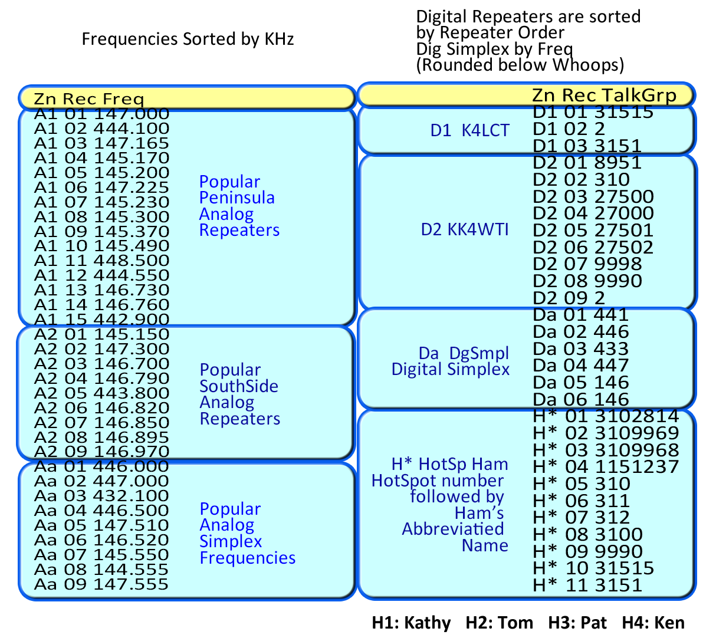
Zone Scheme Cont’d

Slide 23
Operating
Select a Zone.
From that Select a record (Channel).
Listen before talking. Catch 22. Some repeaters require that you Kerchunk before you are recognized to hear anything on the Talk Group you want to hear. After all, until you send it information, how will it know what you want to listen to? People jumping in are likely to be stepping on QSOs in progress. To comply with FCC regulations you must identify yourself.

Slide 24
Operating
Tidewater DMR Net on TalkGroup 31515 Thursday Nights at 2100 Hours. WZ4K ramrods it.
We are still learning. Sometimes I can’t be heard by some participants, while others can hear me. Sometimes I can’t hear some participants while others can hear them. This tells me there is something I still don’t understand. In general, it works well. On rare occasions, in a one to one QSO, the other fellow will drop out. On occasion he’ll return, explaining what he did. I would guess that better than 90-95% of the time it is working well.
Brandmeister
https://brandmeister.network
This offers a listening service called a Hose line. It is found under Services.

Slide 25
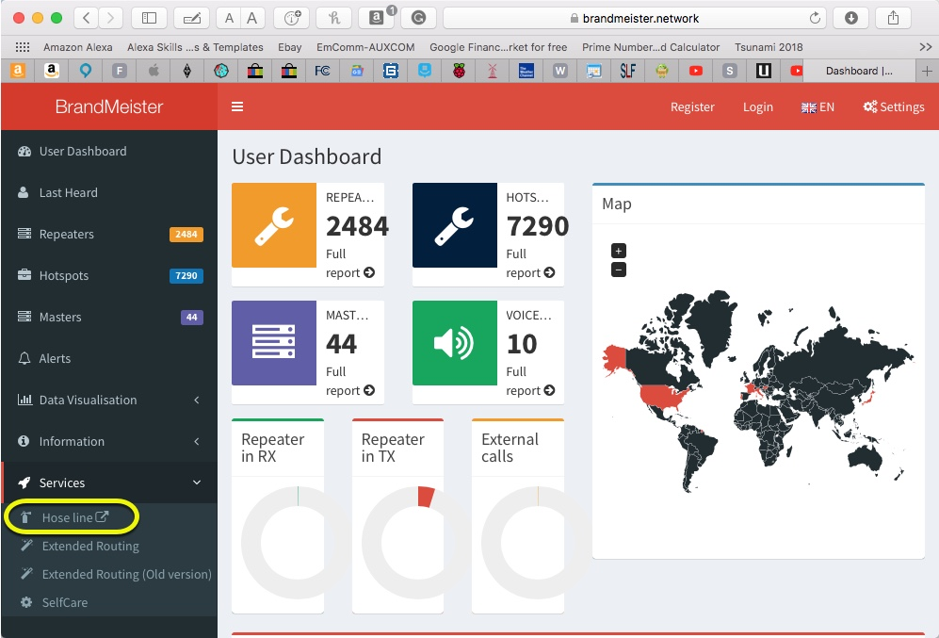
Operating
Hose Line

Slide 26
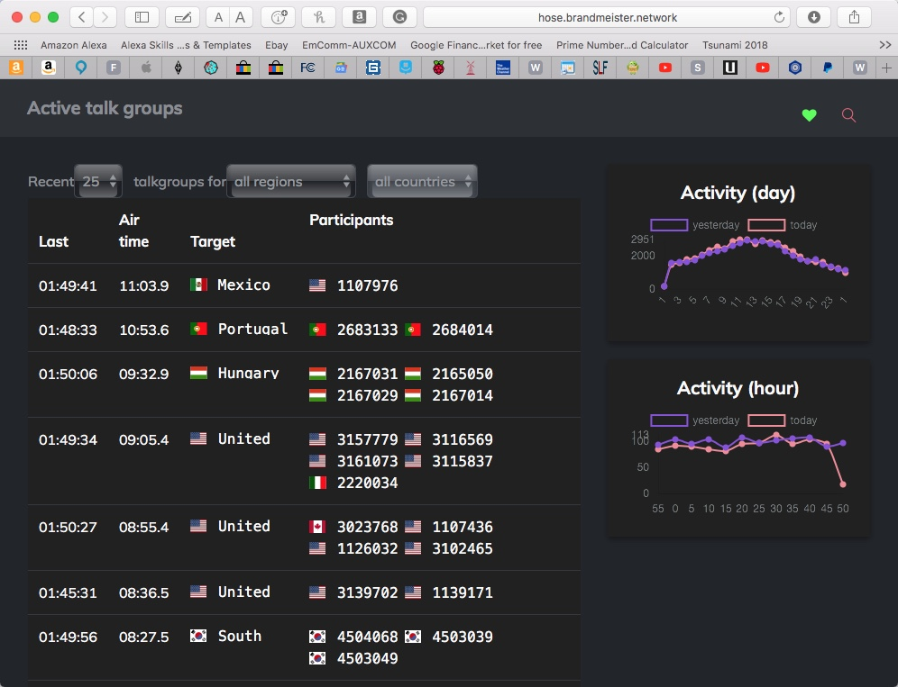
Operating
Hose Line Audio

Slide 27
Sources of Info:
DMR Registration Number
DMR ID: http://www.RadioID.net - Free
Virginia Repeaters
DMRVA: http://www.dmrva.org/
Radio Reviews
VA3XPR – Toronto, Canada: http://www.va3xpr.net/
Hams’ DMR Network
BrandMeister: https://brandmeister.network
HotSpot Software
PiStar.UK - Pi-Star Digital Voice Software: http://www.pistar.uk
Talk Groups
BrandMeister Talk Groups: http://www.mw0mwz.co.uk/dmr_bm_talkgroups.php
ARRL Inputs
Digital Mobile Radio (DMR) - ARRL Ohio Section: http://arrl-ohio.org/digital/digital.html
Introduction to Digital Mobile Radio (DMR):
https://www.qsl.net/kb9mwr/projects/dv/dmr/Introduction%20to%20Digital%20Mobile%20Radio.pdf

Slide 28
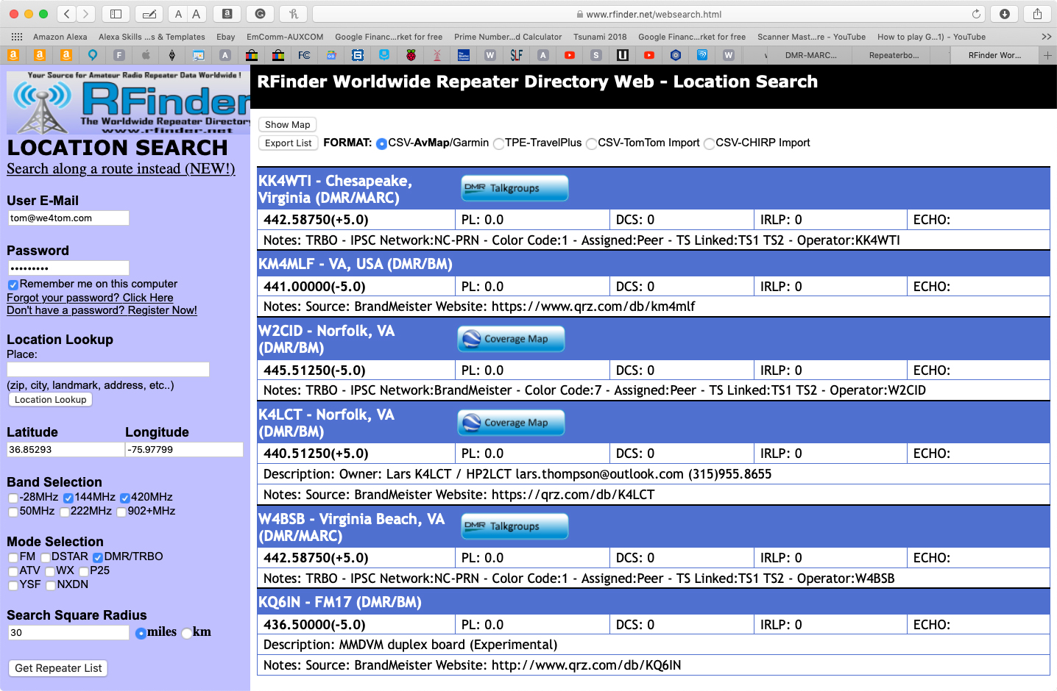

Slide 29
Jump in
and
Enjoy!
WE4TOM
November 2018

